Slide 1
BUDT 703: Database Management Systems
Team 6:
Starving Terps Inc. Analysis of local Pizza restaurants for Master Lee’s Pizza Joint
Nigam Shah
Rahil Pereira
Liangrui (Larry) Lu
Yi-Wei (Barry) Sun
Yu-Shiang (Shawn) Liao

Slide 2
Introduction
Mission Statement:
Starving Terps Inc. is a consulting firm hired by Master Lee’s Pizza Joint to evaluate the local restaurant industry of College Park, MD and help Master Lee’s Pizza Joint open a successful restaurant.
Mission Objectives:
Identify attributes of successful pizza restaurants in the local area
Leverage MS SQL Server to build a database of these restaurants and attributes
Conduct analysis to compare attributes
Develop detailed Tableau dashboard visualizing trends in pizza restaurant industry
Present results to Master Lee’s Pizza Joint to utilize in their restaurant planning process

Slide 3

Background
Users: TripAdvisor users who left restaurant reviews
Data sources: All reviews taken from TripAdvisor
Parameters:
Restaurant Details
Menu Details
Review Details
Customer Details
Delivery Platform Details

Slide 4
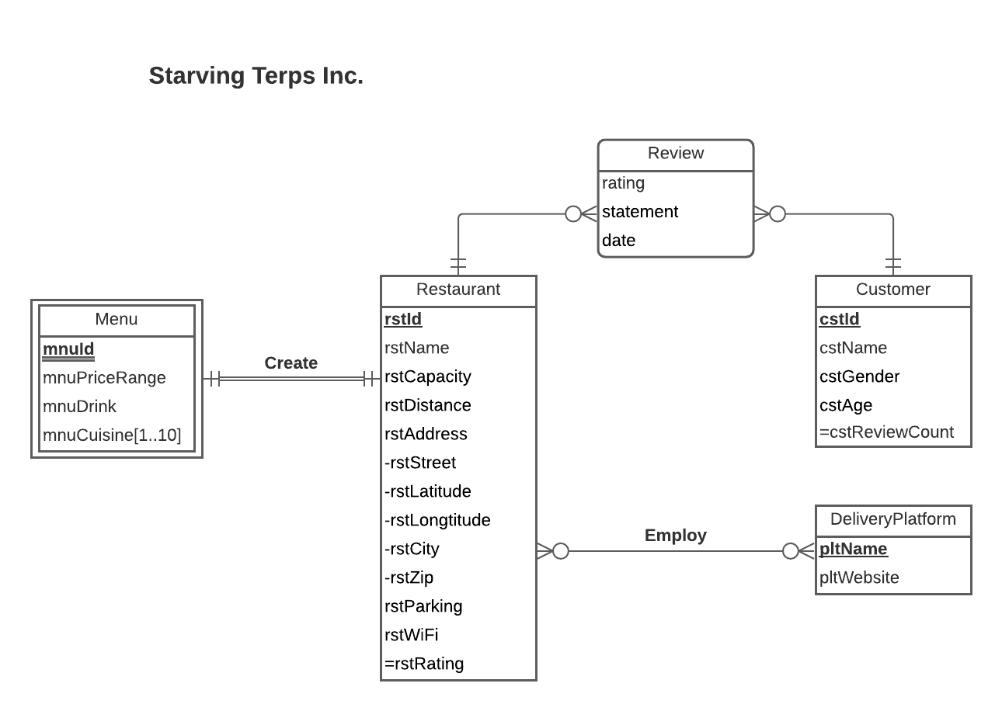
Conceptual Database Design: ER Diagram

Slide 5
Logical Database Design: Relational Schema
Components of a Relation:
A relation is a named, two-dimensional table of data
The columns correspond to the Attributes from the ER Model
The rows correspond to the Entity Instances from the ER Model
Different types of relationships in ER Model have different rules while converting it into a corresponding relation

Slide 6
Logical Database Design: Relational Schema
Relations:
Customers (cstId, cstName, cstGender, cstAge)
Restaurant (rstId, rstName, rstCapacity,
rstDistance,rstStreet, rstLatitude,
rstLongtitude, rstCity, rstZip, rstParking, rstWiFi)
Review (rating, statement, date, rstId, cstId)
Menu (rstId, mnuId,mnuPriceRange,mnuDrink)
MenuCuisine (mnuId, rstId, mnuCuisine)
DeliveryPlatform (pltName, pltWebsite)
Employ(rstId, pltName)

Slide 7
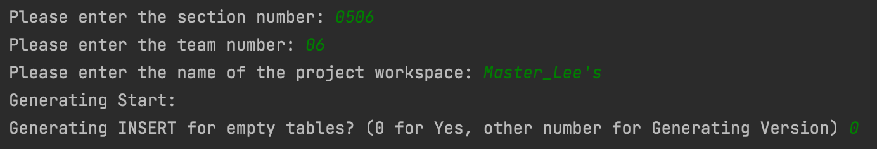
DDL Automation Using Python
An API to put EXCEL data into SQL tables
Data type detection, and corresponding generation to fit in SQL’s Grammar Rule.
Version Control included to generate new rows and avoid duplication
Input:
Excel data, e.g. , Entity_Attribute Tracking.xlsx
Row_Mark_WorkSpaceName_LatestVersion.txt, if any. E.g., Row_Mark_Master_Lee's_0.txt
Input information.

Slide 8
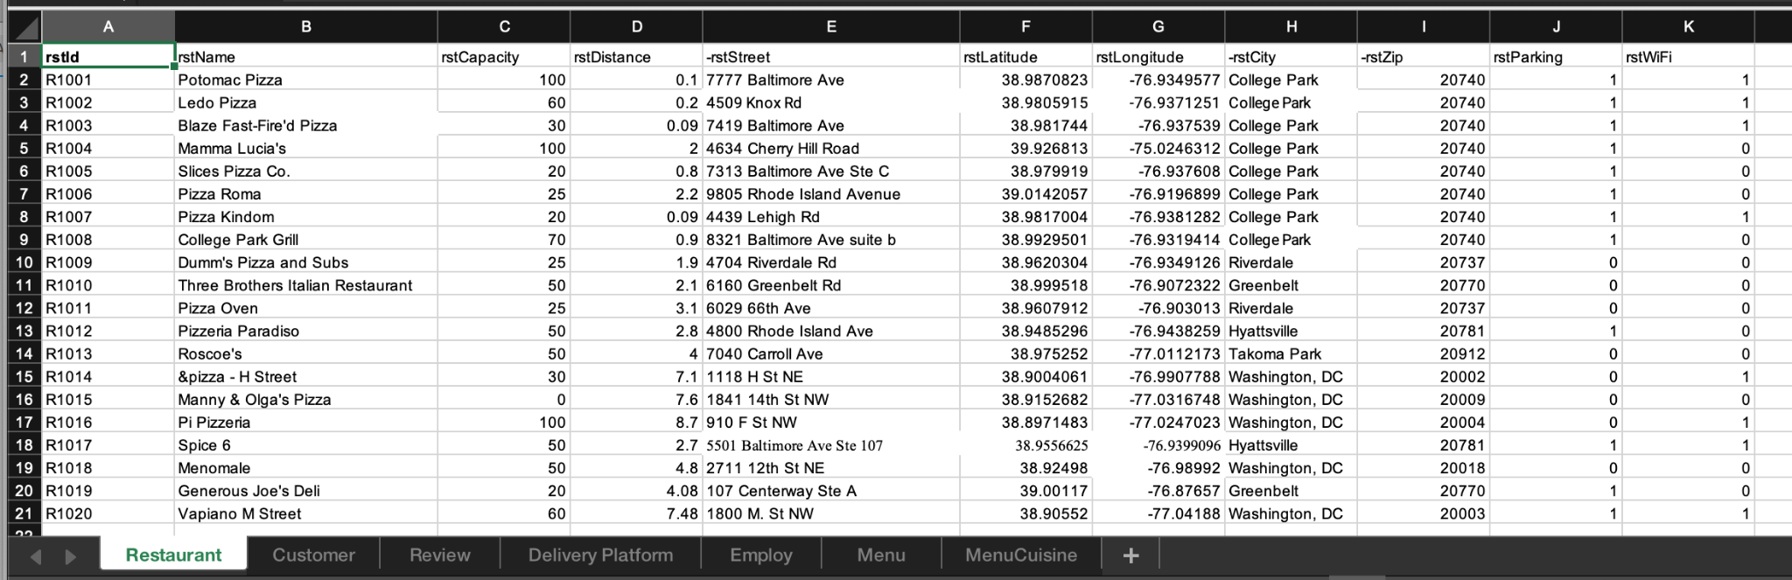
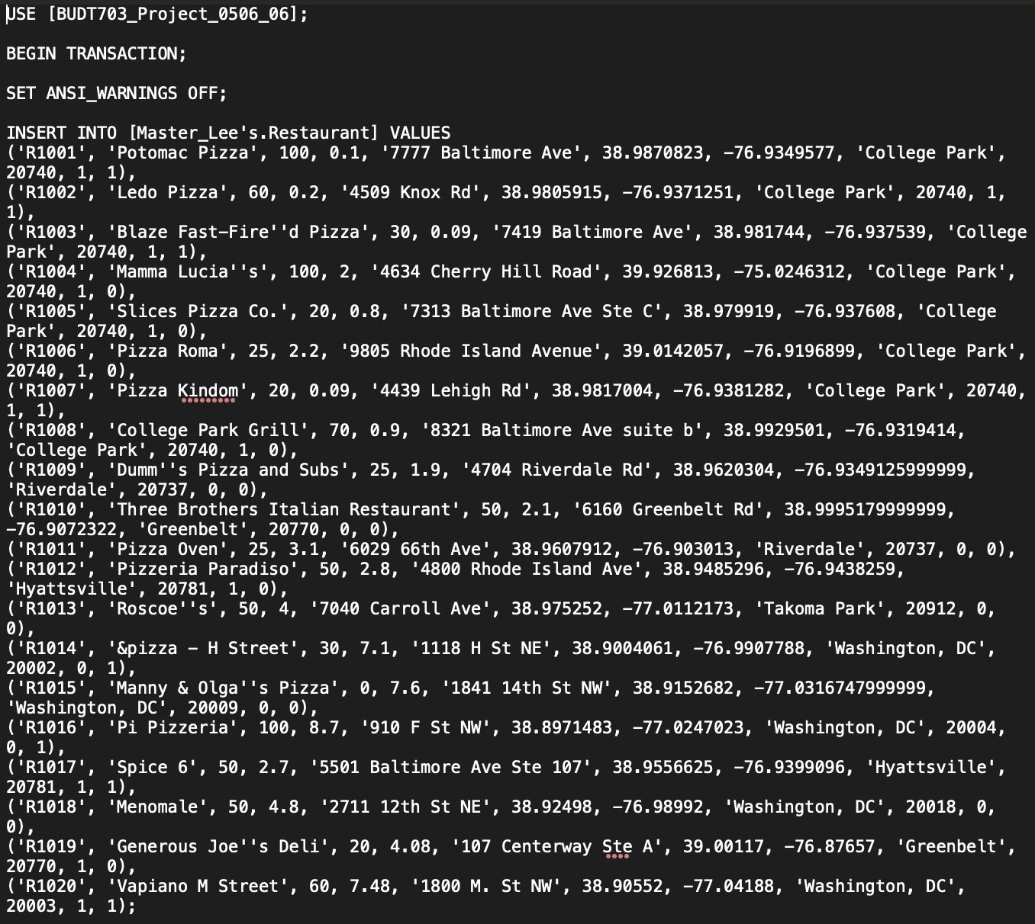
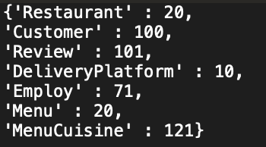
DDL Python Generator Sample Output
Row_Mark_Master_Lee's_0.txt
INSERT_GENE_RESULT.txt

Slide 9
Physical Database Design: SQL CREATE TABLE
Key considerations while creating a table:
Primary Key attribute can never have NULL Values - Entity Integrity
Primary Keys can be composite i.e., composed of multiple attributes
The Foreign Key (if any) references the base table with corresponding referential integrities

Slide 10
Physical Database Design: SQL CREATE TABLE
Example: Creation of Review Table with 2 foreign keys
CREATE TABLE [Master_Lee's.Review] (
rvwRating DECIMAL(1,0) NOT NULL,
rvwStatement VARCHAR(1000),
rvwDate DATE ,
rstId CHAR(5) NOT NULL,
cstId CHAR(5) NOT NULL,
CONSTRAINT pk_Review_rstId_cstId PRIMARY KEY (rstId, cstId),
CONSTRAINT fk_Review_rstId FOREIGN KEY (rstId)
REFERENCES [Master_Lee's.Restaurant] (rstId)
ON DELETE CASCADE ON UPDATE NO ACTION,
CONSTRAINT fk_Review_cstId FOREIGN KEY (cstId)
REFERENCES [Master_Lee's.Customer] (cstId)
ON DELETE CASCADE ON UPDATE NO ACTION)

Slide 11
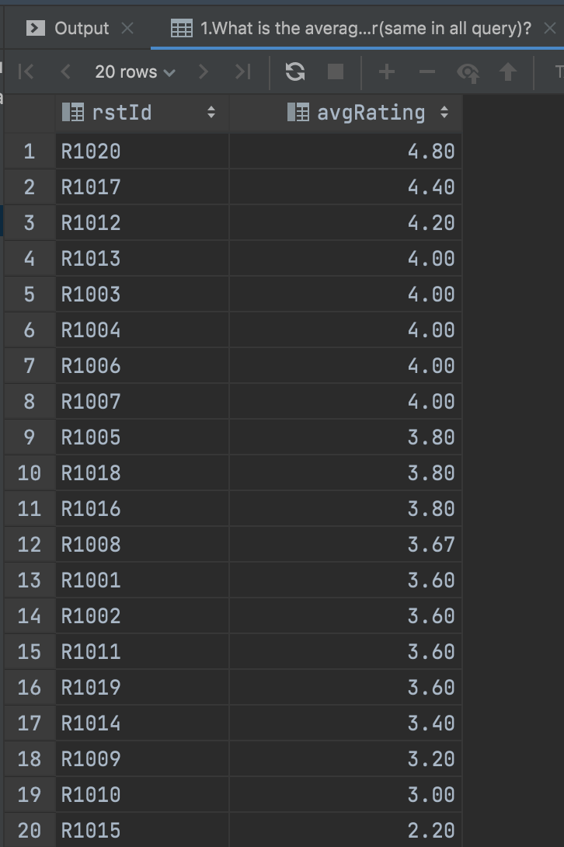
View table for derived attributes 1
Create VIEW for derived attribute: rstAvgRating.
CREATE VIEW rstAvgRating AS
SELECT r.rstId,
CAST(AVG (rv.rvwRating)
AS DECIMAL(3,2))
AS avgRating
FROM [Master_Lee's.Restaurant] r,
[Master_Lee's.Review] rv
WHERE r.rstId=rv.rstId
GROUP BY r.rstId

Slide 12
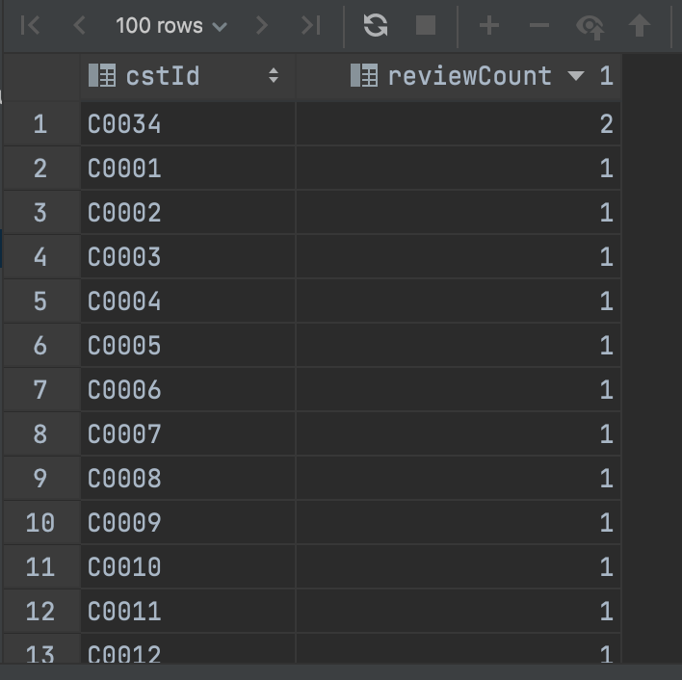
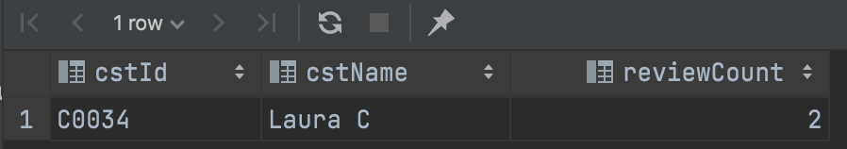
View table for derived attributes 2
Create VIEW for derived attribute: cstReviewCount.
CREATE VIEW cstReviewCount AS
SELECT c.cstId, COUNT(c.cstId) reviewCount
FROM [Master_Lee's.Customer] c, [Master_Lee's.Review] rv
WHERE c.cstId=rv.cstId
GROUP BY c.cstId
-- Are there any customers that
comments multiple times?
SELECT c1.cstId, c1.cstName, c2.reviewCount
FROM [Master_Lee's.Customer] c1,
cstReviewCount c2
WHERE c1.cstId = c2.cstId
AND c2.reviewCount > 1

Slide 13
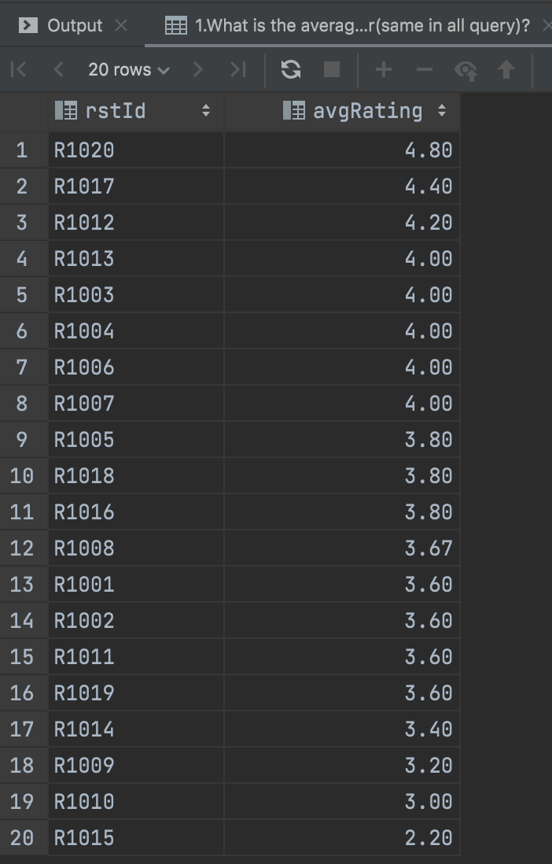
Business Transaction 1
What is the average restaurant rating based on customer review in descending order?
SELECT * FROM rstAvgRating
ORDER BY avgRating DESC

Slide 14
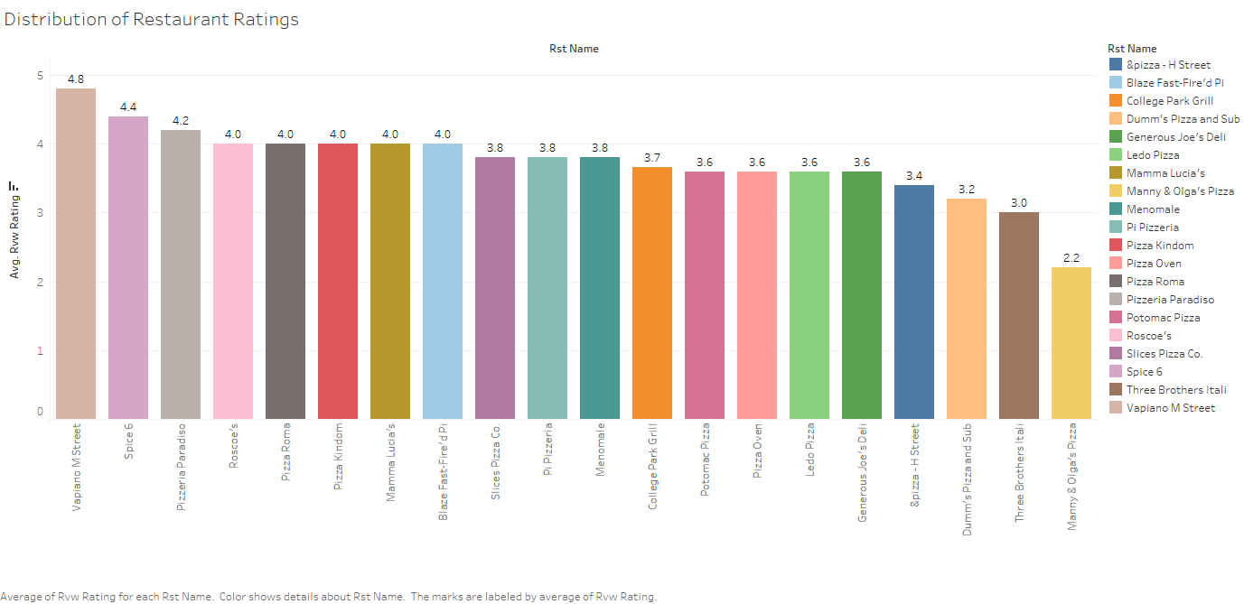
Distribution of Restaurant Ratings

Slide 15
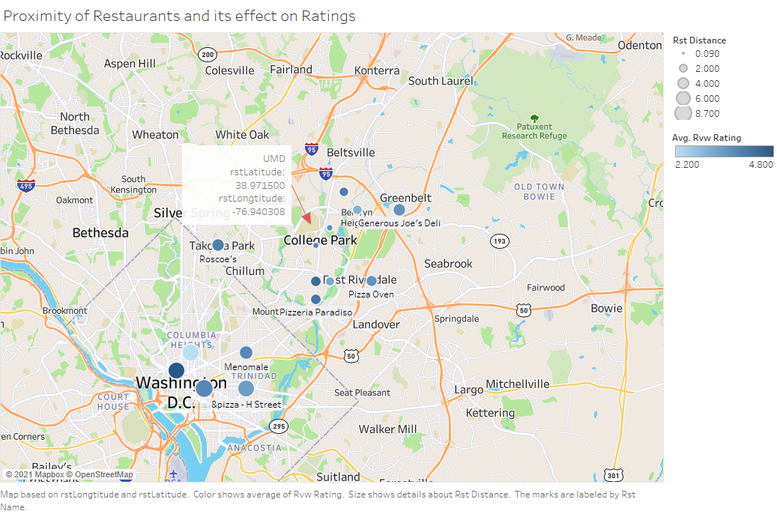
Business Transaction 2
Proximity of Restaurants and its effect on Ratings

Slide 16
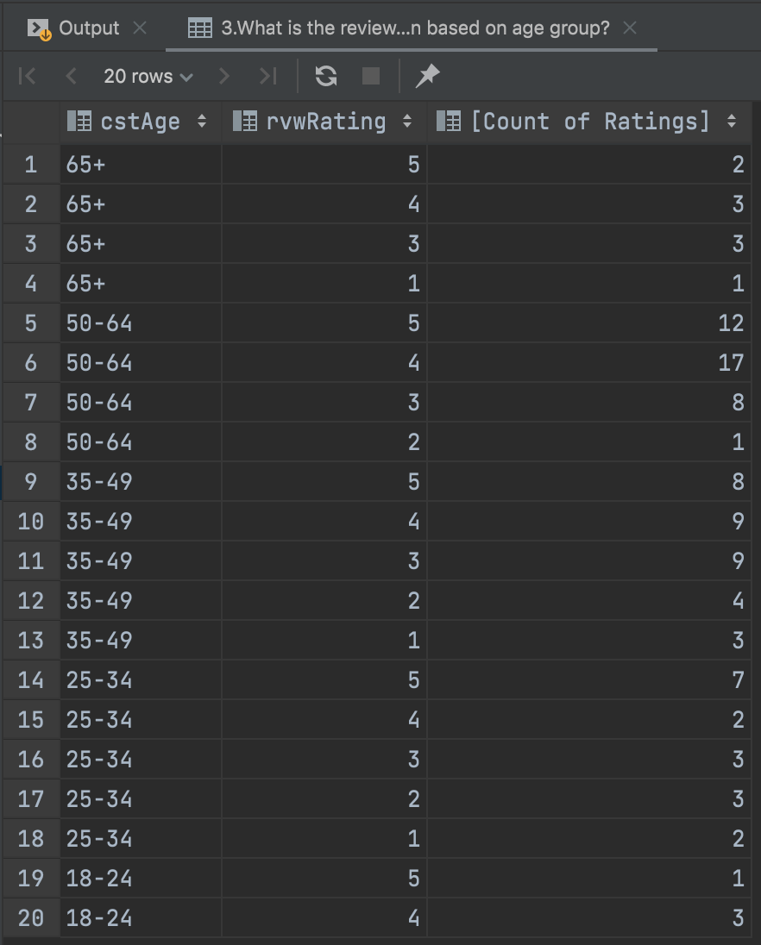
Business Transaction 3
What is the review distribution based on age group and gender?
SELECT c.cstAge, rv.rvwRating, COUNT (c.cstAge) AS 'Count of Ratings'
FROM [Master_Lee's.Restaurant] r, [Master_Lee's.Review] rv, [Master_Lee's.Customer] c
WHERE rv.cstId=c.cstId AND r.rstId=rv.rstId
GROUP BY c.cstAge, rv.rvwRating
ORDER BY c.cstAge DESC, rv.rvwRating DESC

Slide 17
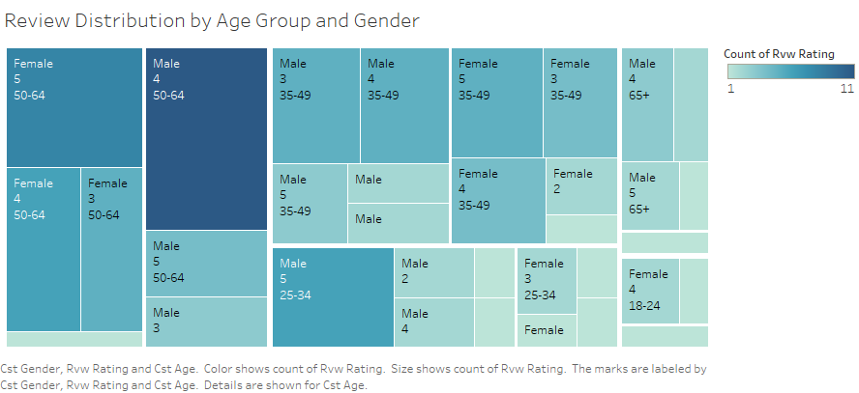
Distribution of Ratings based on Age Group and Gender

Slide 18
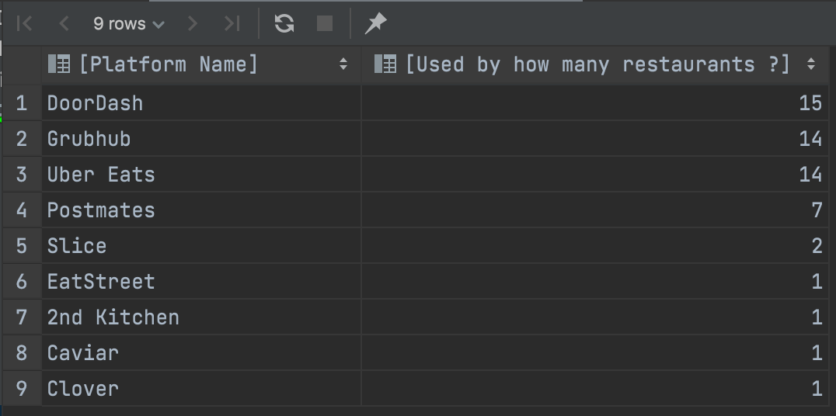
Business Transaction 4
What are the popularity of these delivery platforms?
SELECT p.pltName AS ‘Platform Name’, COUNT(r.rstId)
AS ‘Used by how many restaurants ?'
FROM [Master_Lee's.DeliveryPlatform] p,
[Master_Lee's.Restaurant] r,
[Master_Lee's.Employ] e
WHERE r.rstId=e.rstId AND e.pltName = p.pltName AND p.pltName NOT LIKE 'Self_delivery'
GROUP BY p.pltName
ORDER BY [Used by how many restaurants ?] DESC

Slide 19
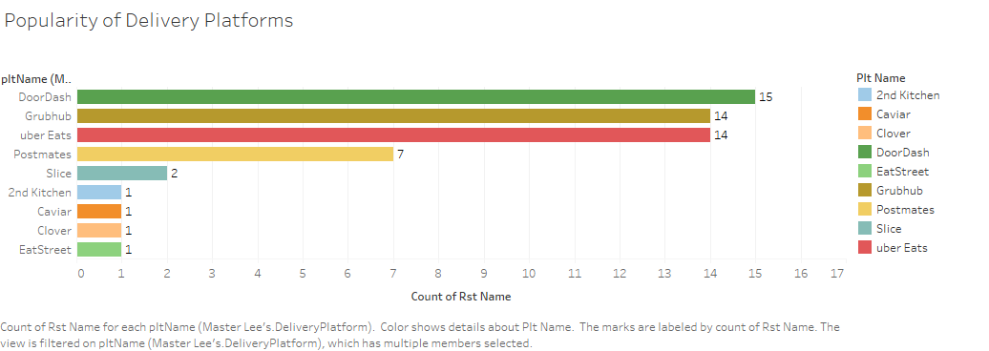
Popularity of Delivery Platforms

Slide 20
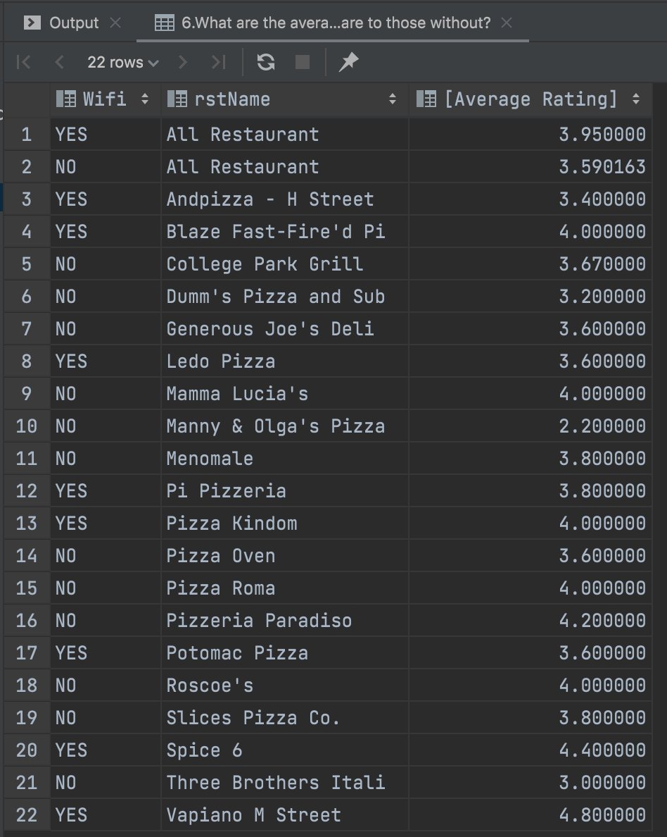
Business Transaction 5
What are the average rating of restaurant with Wifi compare to those without?
SELECT CASE WHEN r.rstWiFi = 1 THEN 'YES' ELSE 'NO' END AS 'Wifi', r.rstName,
ravg.avgRating AS 'Average Rating'
FROM [Master_Lee's.Restaurant] r,
[Master_Lee's.Review] rv,
rstAvgRating ravg
WHERE r.rstId = rv.rstId AND r.rstId=ravg.rstId
GROUP BY r.rstWifi, r.rstName, ravg.avgRating
UNION
SELECT CASE WHEN r.rstWifi = 1 THEN 'YES' ELSE 'NO' END AS 'Wifi', 'All Restaurant', AVG(rv.rvwRating) AS 'Average Rating'
FROM [Master_Lee's.Restaurant] r,
[Master_Lee's.Review] rv
WHERE r.rstId = rv.rstId
GROUP BY r.rstWifi
ORDER BY r.rstName, Wifi DESC

Slide 21
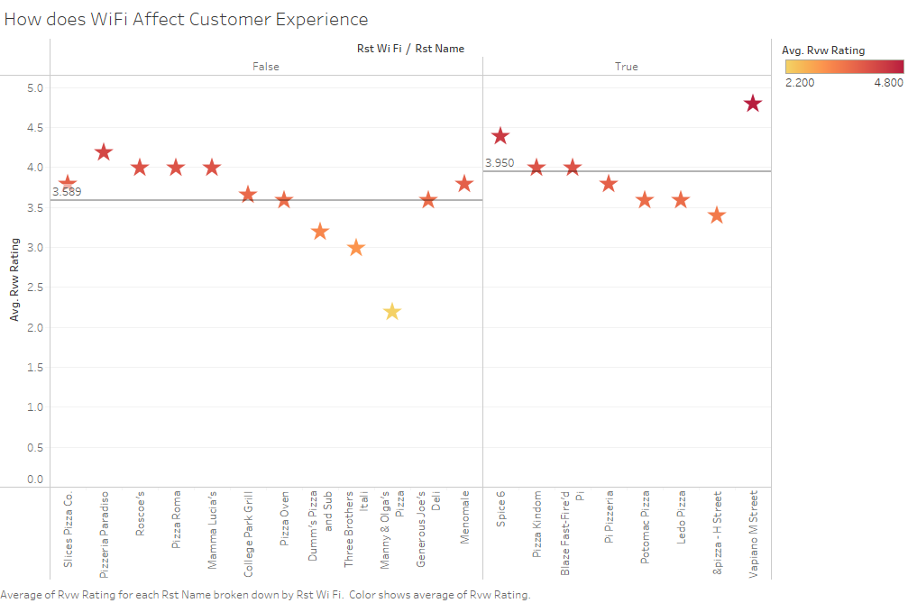
How does WiFi Affect Customer Experience

Slide 22
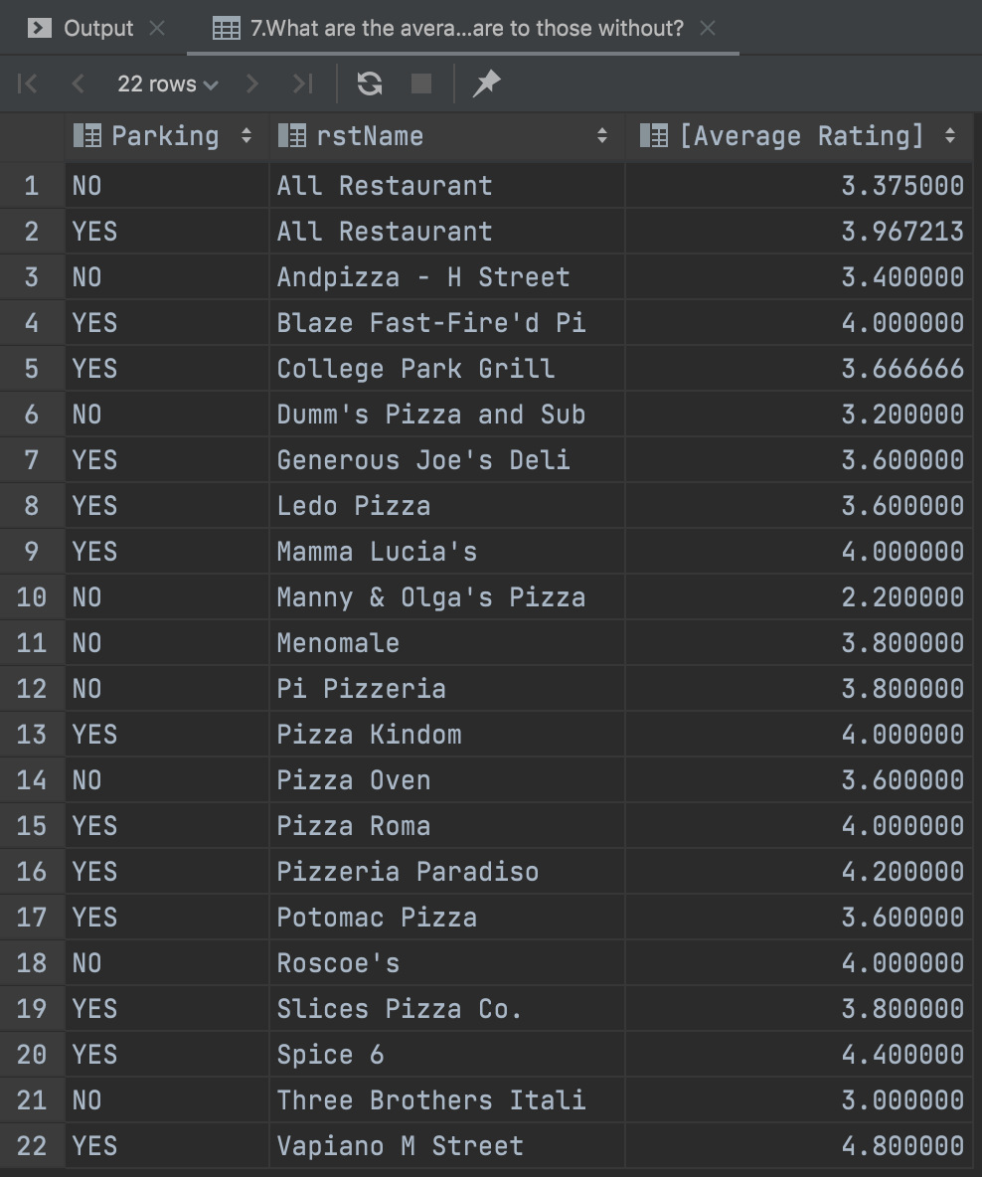
Business Transaction 6
What are the average rating of restaurant with parking space compared to those without?
SELECT CASE WHEN r.rstParking = 1 THEN 'YES' ELSE 'NO' END AS 'Parking',
r.rstName,
AVG(rv.rvwRating) AS 'Average Rating'
FROM [Master_Lee's.Restaurant] r, [Master_Lee's.Review] rv
WHERE r.rstId = rv.rstId
GROUP BY r.rstParking, r.rstName
UNION
SELECT CASE WHEN r.rstParking = 1 THEN 'YES' ELSE 'NO' END AS 'Parking',
'All Restaurant', AVG(rv.rvwRating) AS 'Average Rating'
FROM [Master_Lee's.Restaurant] r, [Master_Lee's.Review] rv
WHERE r.rstId = rv.rstId
GROUP BY r.rstParking
ORDER BY r.rstName

Slide 23
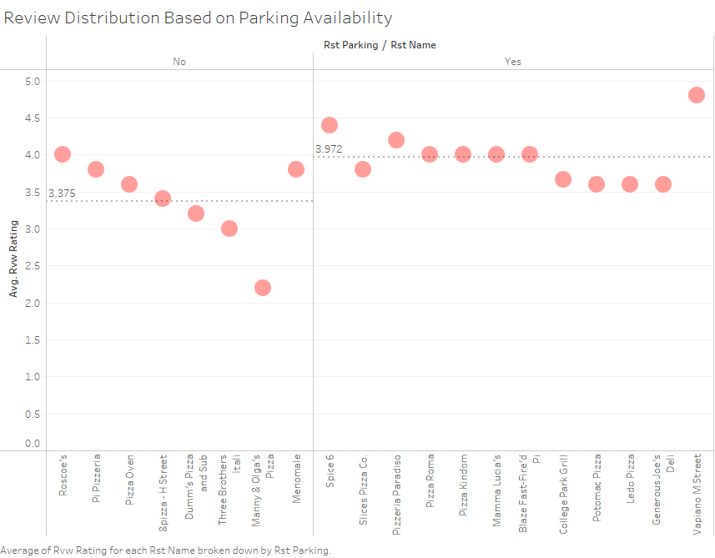
Rating Distribution Based on Parking Availability

Slide 24
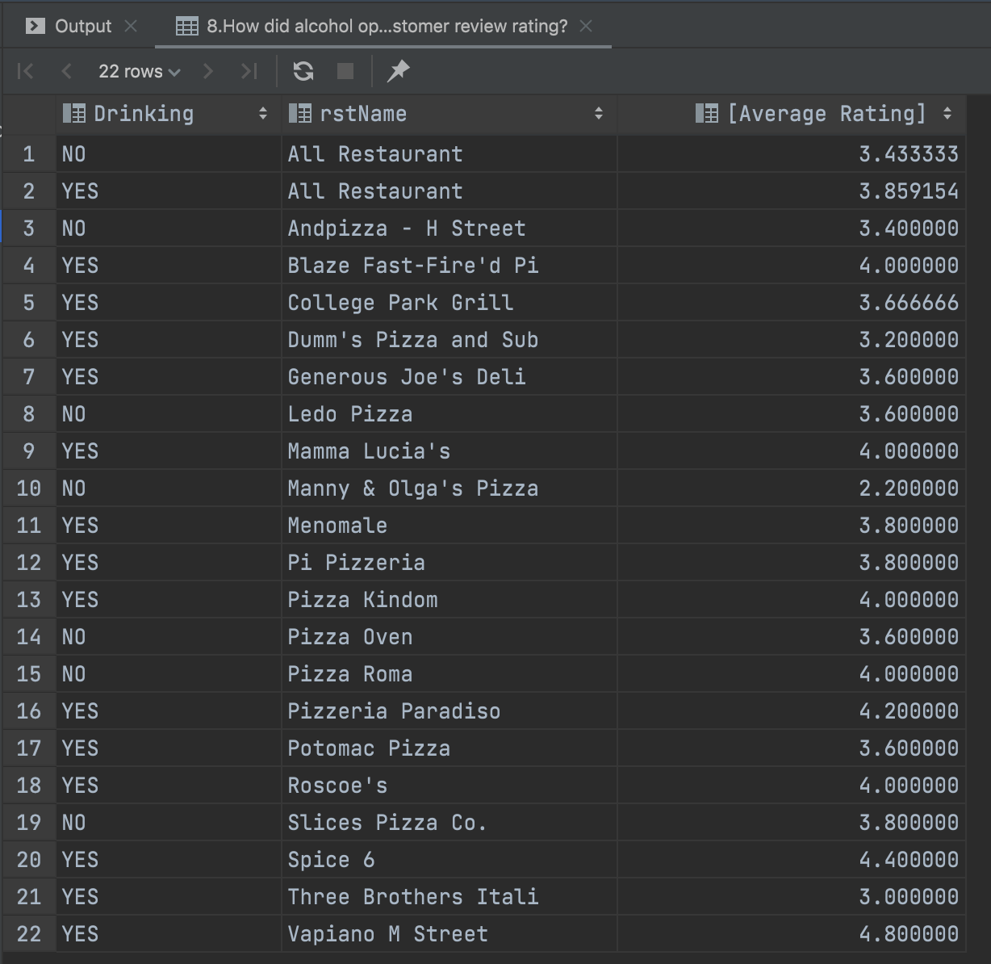
Business Transaction 7
How did alcohol option affect customer review rating?
SELECT CASE WHEN m.mnuDrink = 1 THEN 'YES' ELSE
'NO' END AS 'Drinking', r.rstName,
AVG(rv.rvwRating) AS 'Average Rating'
FROM [Master_Lee's.Menu] m,
[Master_Lee's.Review] rv,
[Master_Lee's.Restaurant] r,
rstAvgRating ravg
WHERE r.rstId = rv.rstId AND r.rstId = m.rstId AND r.rstId = ravg.rstId
GROUP BY m.mnuDrink, r.rstName
UNION
SELECT CASE WHEN m.mnuDrink = 1 THEN 'YES' ELSE
'NO' END AS 'Parking','All Restaurant',
AVG(rv.rvwRating) AS 'Average Rating'
FROM [Master_Lee's.Restaurant] r,
[Master_Lee's.Review] rv,
[Master_Lee's.Menu] m
WHERE r.rstId = rv.rstId AND r.rstId = m.rstId
GROUP BY m.mnuDrink
ORDER BY r.rstName

Slide 25
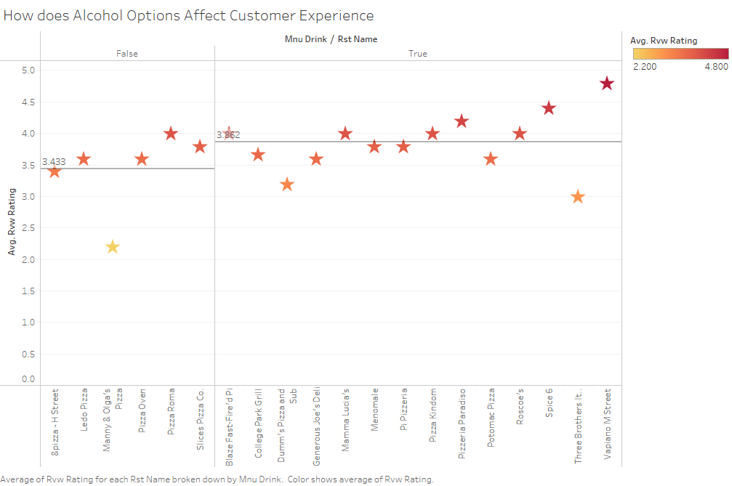
How does Alcohol Options Affect Customer Experience

Slide 26
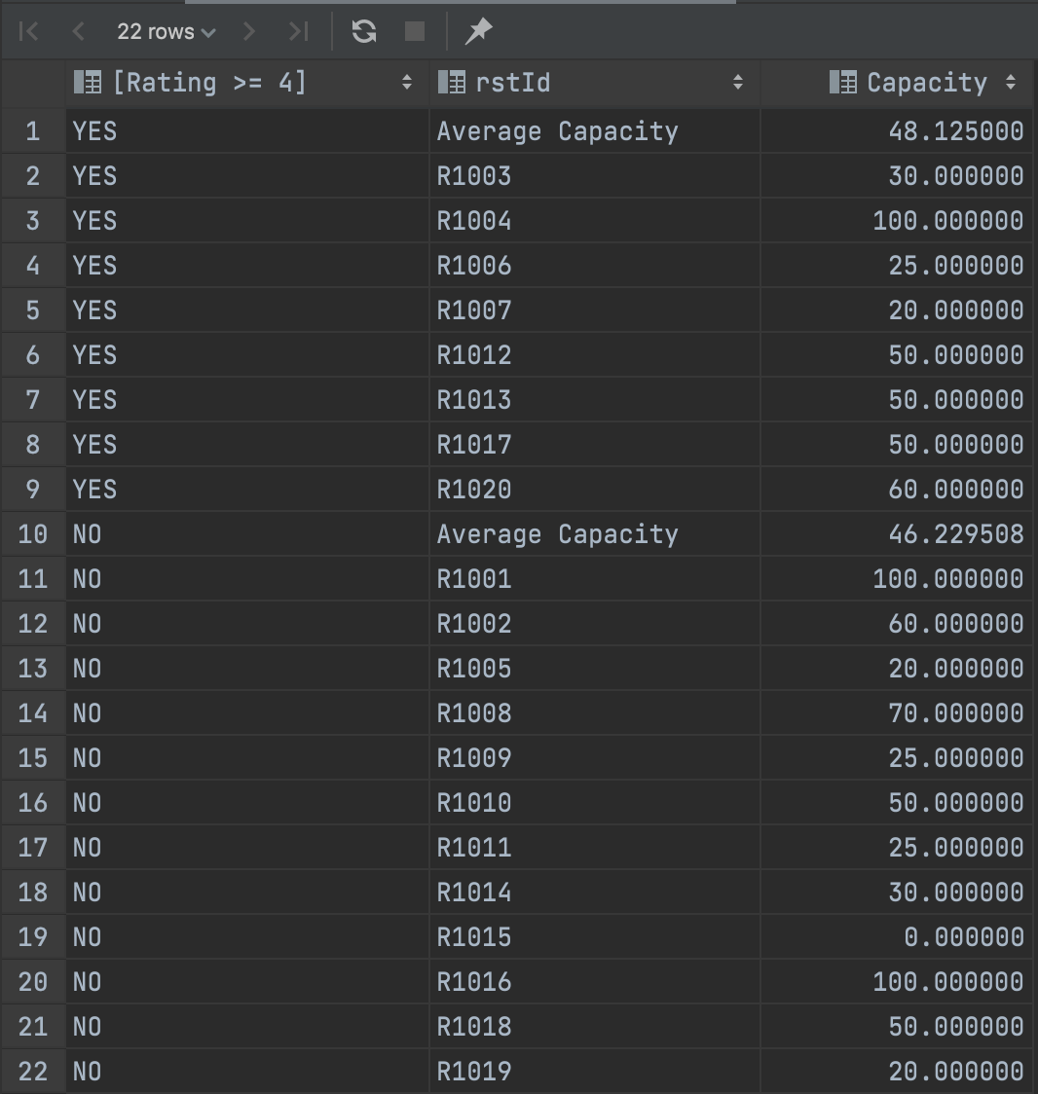
Business Transaction 8
What are the average seating capacity for restaurant with average rating >= 4 and without?
SELECT CASE WHEN ravg.avgRating >= 4 THEN 'YES'
ELSE 'NO' END AS 'Rating >= 4', r.rstId,
AVG(r.rstCapacity) AS ‘Capacity'
FROM [Master_Lee's.Restaurant] r,
[Master_Lee's.Review] rv,
rstAvgRating ravg
WHERE r.rstId = rv.rstId AND r.rstId = ravg.rstId
GROUP BY r.rstId, ravg.avgRating
UNION
SELECT CASE WHEN ravg.avgRating >= 4 THEN 'YES'
ELSE 'NO' END AS 'Rating >= 4', 'Average Capacity',
AVG(r.rstCapacity) AS 'Capacity'
FROM [Master_Lee's.Restaurant] r,
[Master_Lee's.Review] rv,
rstAvgRating ravg
WHERE r.rstId = rv.rstId AND r.rstId = ravg.rstId
GROUP BY CASE WHEN ravg.avgRating >= 4 THEN 'YES' ELSE 'NO' END
ORDER BY [Rating >= 4] DESC, r.rstId

Slide 27
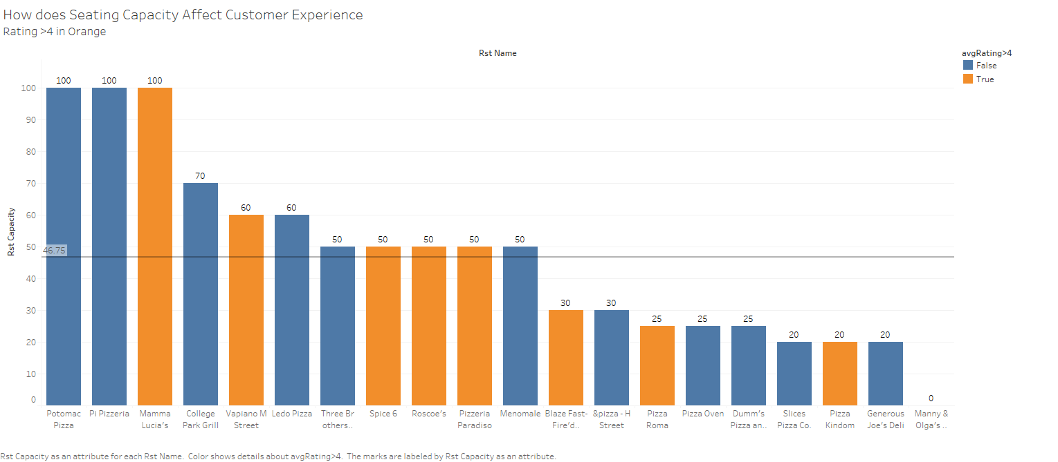
How does Seating Capacity Affect Customer Experience
Rating >4 in Orange

Slide 28
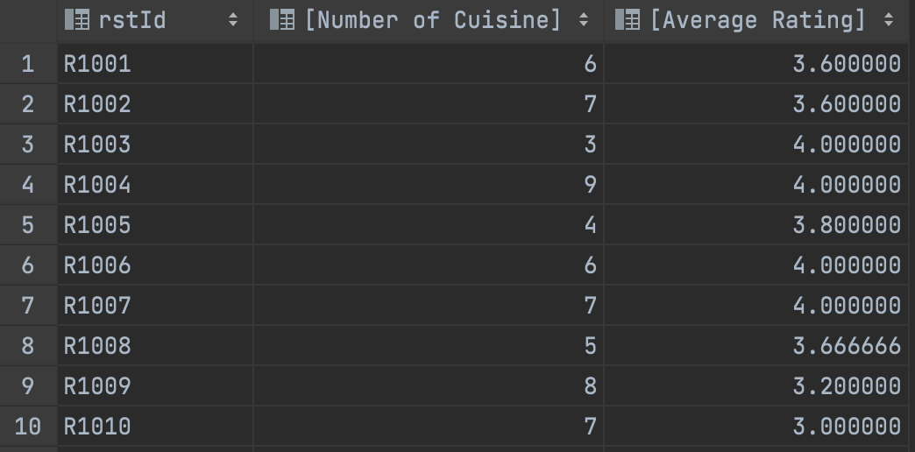
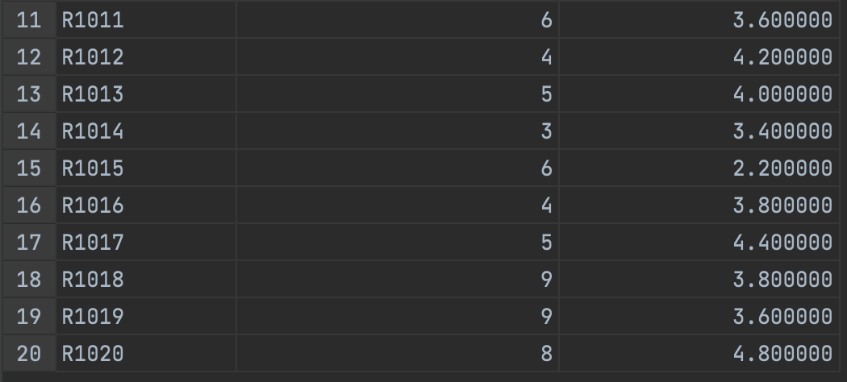
Business Transaction 9
How does the count of Menu Cuisine Affect Rating?
SELECT m.rstId,COUNT(DISTINCT m.mnuCuisine) AS 'Number of Cuisine', AVG(rv.rvwRating) AS 'Average Rating'
FROM [Master_Lee's.Review] rv, [Master_Lee's.MenuCuisine] m
WHERE rv.rstId = m.rstId
GROUP BY m.rstId
ORDER BY m.rstId

Slide 29
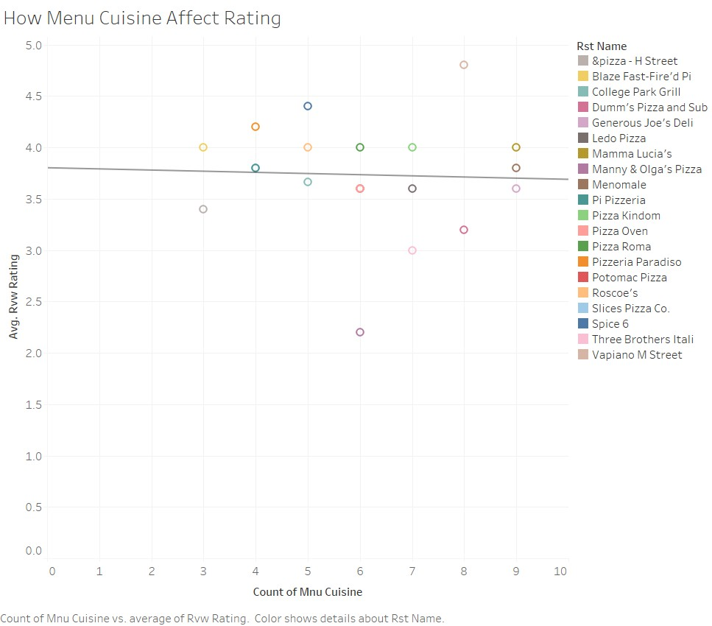
Effect of Number of Menu Cuisine on Restaurant Review

Slide 30
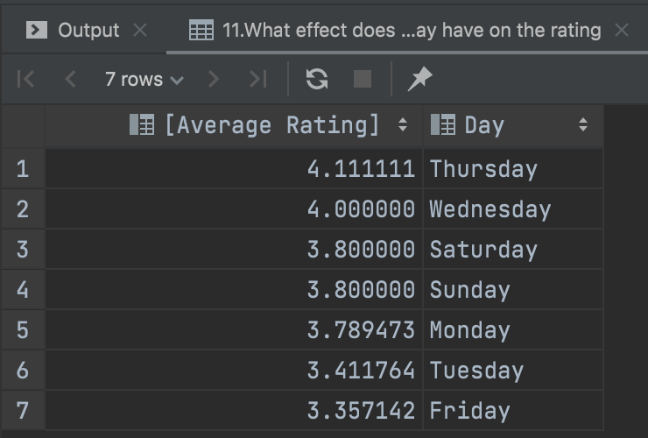
Business Transaction 10
What is the review distribution based on days of week?
SELECT AVG (rv.rvwRating) AS 'Average Rating', DATENAME (WEEKDAY, rv.rvwDate) AS 'Day'
FROM [Master_Lee's.Review] rv
GROUP BY DATENAME (WEEKDAY, rv.rvwDate)
ORDER BY [Average Rating] DESC

Slide 31
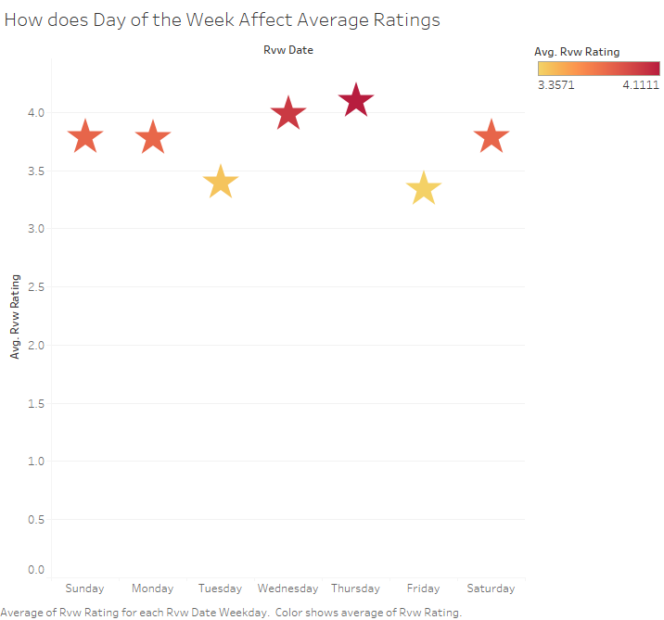
How does Day of the Week Affect Average Ratings

Slide 32
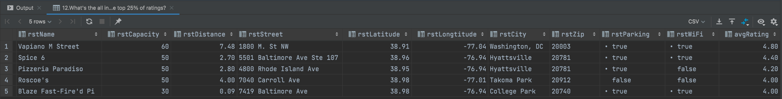
Business Transaction 11
What's the all information of restaurants that are in the top 25% of ratings?
SELECT TOP(25) PERCENT r.*, ravg.avgRating
FROM [Master_Lee's.Restaurant] r, rstAvgRating ravg
WHERE r.rstId= ravg.rstId
ORDER BY ravg.avgRating DESC

Slide 33
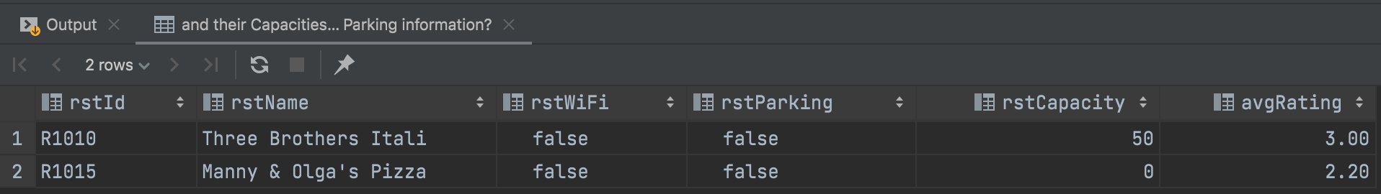
Business Transaction 12
What are ids, names and average ratings of restaurants that have a average rating below 3(include 3), and their Capacities and WIFI, Parking information?
SELECT r.rstId, r.rstName,r.rstWiFi,r.rstParking,r.rstCapacity, v.avgRating
FROM [Master_Lee's.Restaurant] r, rstAvgRating ravg
WHERE r.rstId= ravg.rstId
AND ravg.avgRating <= 3
ORDER BY ravg.avgRating DESC

Slide 34
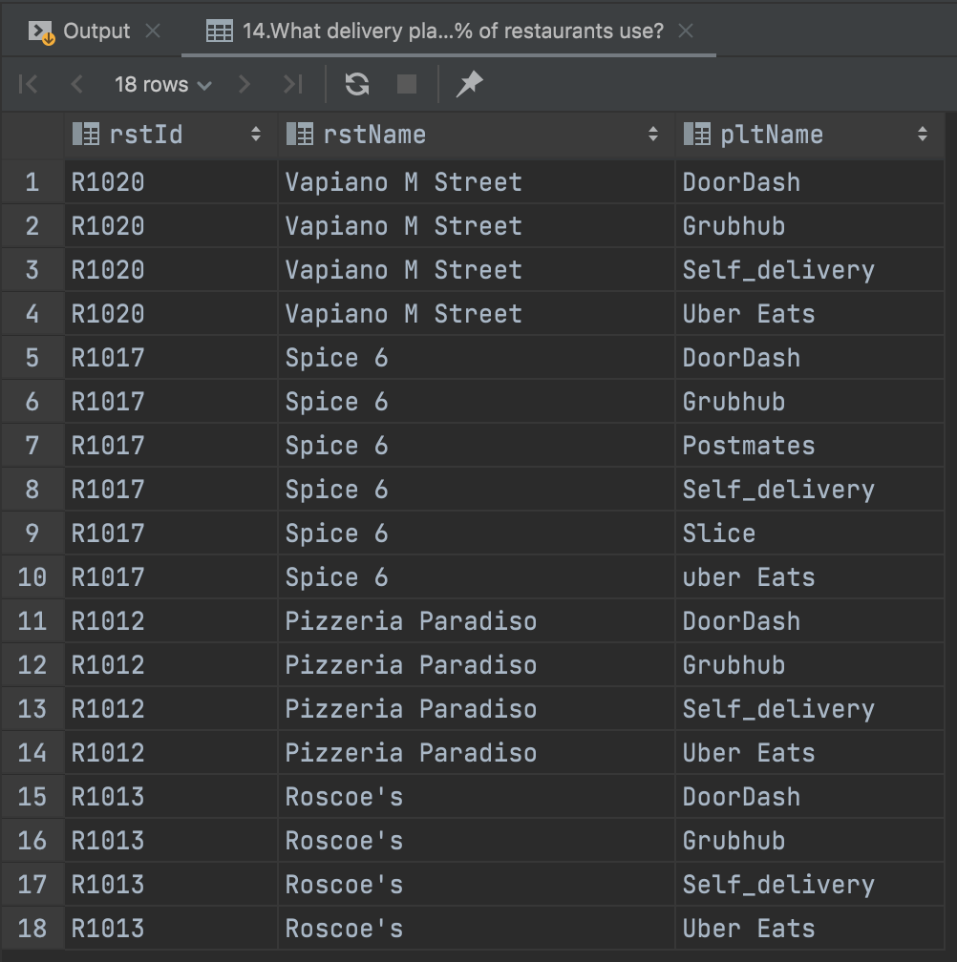
Business Transaction 13
What's the all information of restaurants that are in the top 25% of ratings?
SELECT TOP(25) PERCENT r.*, v.avgRating
FROM [Master_Lee's.Restaurant] r, rstAvgRating ravg
WHERE r.rstId= ravg.rstId
ORDER BY ravg.avgRating DESC
Notes:
Same thing used twice..removed from the DML file, make corrections here

Slide 35
Recommendations For Master Lee’s Pizza Joint
Findings:
Parking matters: Customers prefer restaurants that have ample parking.
Wifi: Customers look for wifi at pizza restaurants. Could be attributed to the younger college demographic
Drink: Having alcohol options affect customer rating and consequently, rating of the restaurant
Delivery: Customers like having delivery options. The more options, the higher the ratings get
Interesting findings:
Seating: Seating capacity does not matter. A lot of customers get takeout and prefer more cozy settings
Cuisine options: Having more options do not affect ratings, people are just looking for quality pizza
Proximity: The further from the school the lower the rating gets

Slide 36
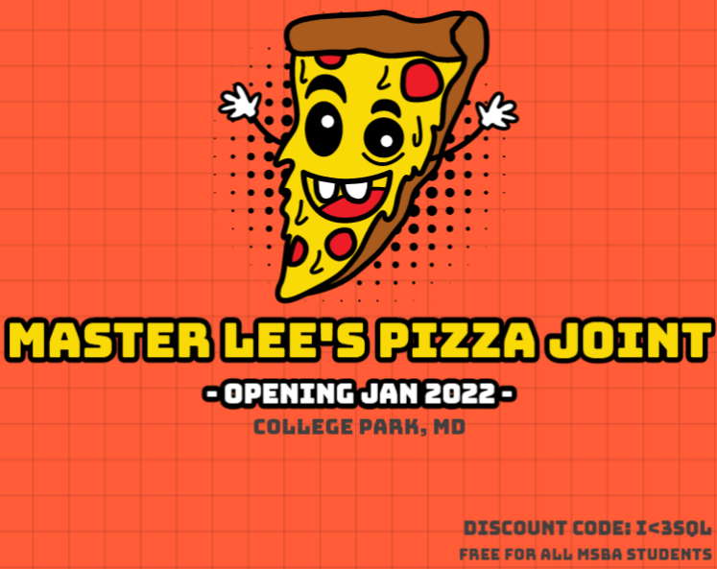
Thank You!
Questions

